Slide 1
Department of MCA
Advanced Programming : 21MCA3041
Module 4: Graphical User Interface with Windows Forms and WPF Handling By
Nirupama K
Asst. Prof. Dept. of MCA

Slide 2
New Features of WPF
WPF is a UI framework. Used to create interactive client appliacations
It is used to develop various applications. WPF uses XAML language
Some new features for WPF
New WPF control to develop business applications
Support for development of touch enabled application
Visual state manager (VSM)
Selection and Caret brushes
New WPF text rendering stack
Improvement in XAML browser applications (XBAPs)

Slide 3
New WPF Controls
DataGrid:
Calendar:
DatePicker:
Spports to develop touch enabled application

Slide 4
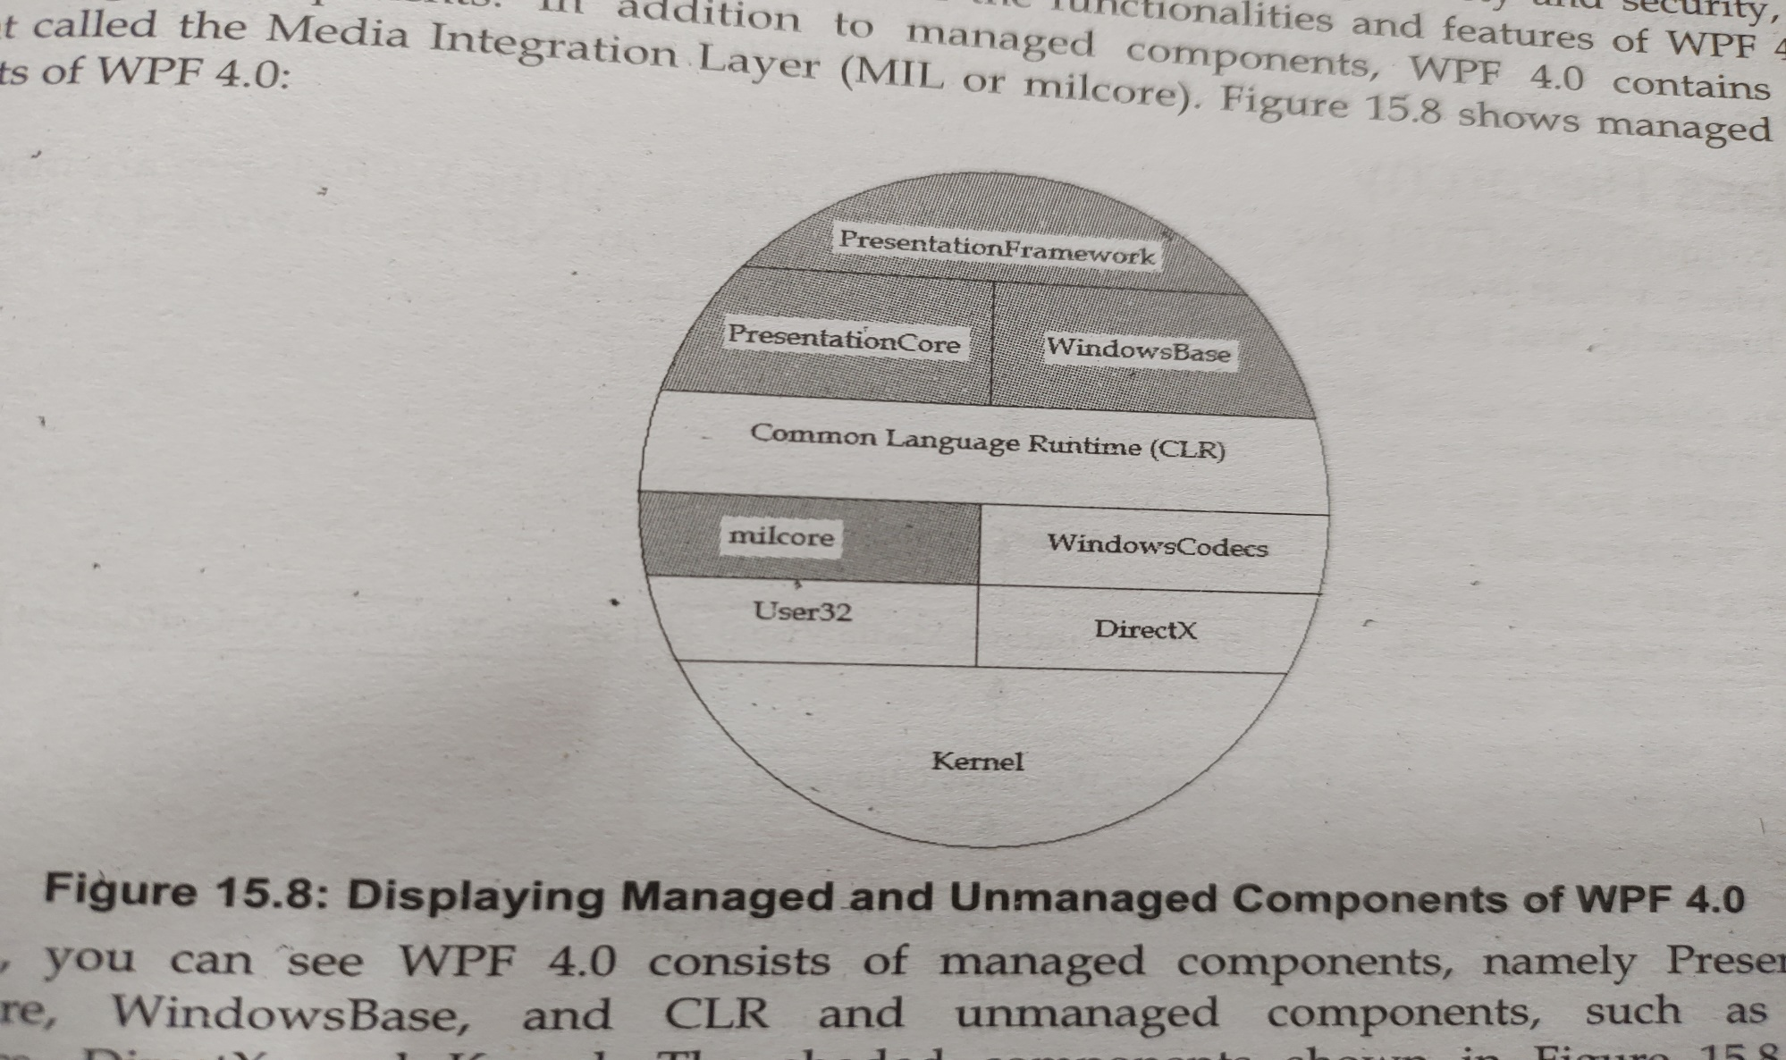
WPF 4.0 architecture

Slide 5
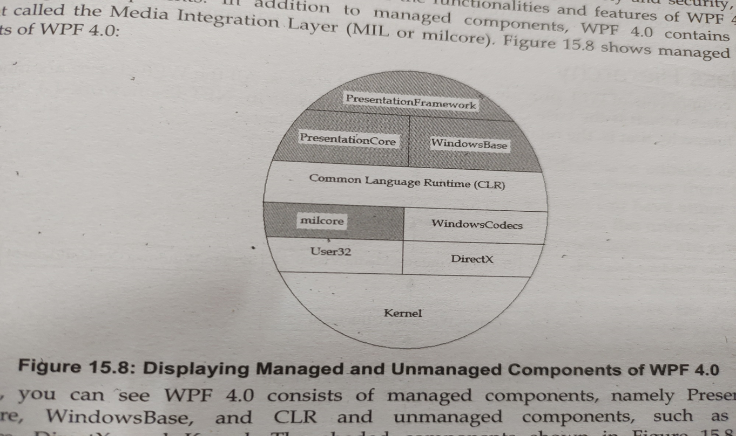

Slide 6
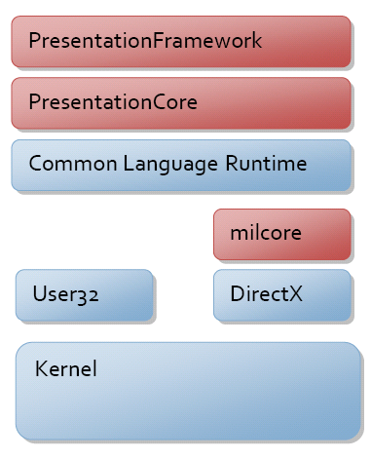

Slide 7
Introduction to XAML
One of the first things you will encounter while working with WPF is XAML. XAML stands for
Extensible Application Markup Language. It’s a simple and declarative language based on XML.
In XAML, it very easy to create, initialize, and set properties of objects with hierarchical relations.
It is mainly used for designing GUIs, however it can be used for other purposes as well, e.g., to declare workflow in Workflow Foundation.
Basic Syntax
When you create your new WPF project, you will encounter some of the XAML code by default in MainWindow.xaml as shown below.
<Window x:Class = "Resources.MainWindow"
xmlns = "http://schemas.microsoft.com/winfx/2006/xaml/presentation"
xmlns:x = "http://schemas.microsoft.com/winfx/2006/xaml"
Title = "MainWindow" Height = "350" Width = "525">
<Grid> </Grid> </Window>

Slide 8
Information | Description
<Window | It is the opening object element or container of the root.
x:Class = "Resources.MainWindow" | It is a partial class declaration which connects the markup to the partial class code defined behind.
xmlns = "http://schemas.microsoft.com/win fx/2006/xaml/presentation" | Maps the default XAML namespace for WPF client/framework
xmlns:x = "http://schemas.microsoft.com/w infx/2006/xaml" | XAML namespace for XAML language which maps it to x: prefix
> | End of object element of the root
<Grid> </Grid> | It is starting and closing tags of an empty grid object.
</Window> | Closing the object element

Slide 9
Namespaces and XAML
A XAML namespace is really an extension of the concept of an XML namespace.
The primary concept that is added to the XAML definition of the XML namespace is that a XAML namespace implies both a scope of uniqueness for the markup usages, and also influences how markup entities are potentially backed by specific CLR namespaces and referenced assemblies
You can define XAML namespace using xmlns attribute
xmlns=http://schemas.microsoft.com/winfx/2006/xaml/presentation
The second declaration maps a separate XAML namespace, mapping it (typically) to the x: prefix.
xmlns:x=http://schemas.microsoft.com/winfx/2006/xaml
You can also create your own namespaces and use it in XAML file by adding an XAML adding root elements of these files

Slide 10
xmlns:custom="clr-namespace:SDKSample;assembly=SDKSampleLibrary“
Xmlns: custom_prefix=“clr-namespace:namespace_name; assembly= assembly_name”
XAML Property Syntax
<element_name.property_name [attribute_name=“value1” attribute_name=“value2” …. [attribute_name=“valueN” ]> property_name</ element_name.property_name>
element_name- specifies the name element to which the property belongs
Property-name- specifies the property name
attribute1_name, attribute2_name… attributeN_name- specifies the name of any attribute that the property may contain
Value1, Value2, Value3… ValueN – specifies the value of the attributes
Property_value- specifies the value of the property

Slide 11
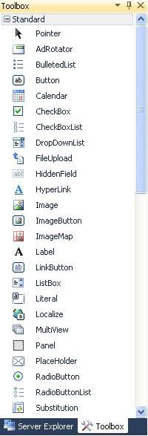
Tool box controls

Slide 12
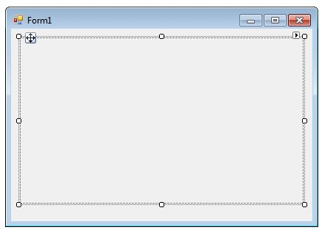
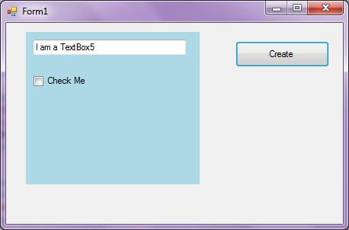
Panel
The Panel Control is a container control to host a group of similar child controls. One of the major uses I have found for a Panel Control is when you need to show and hide a group of controls.
We can create a Panel Control using the Forms designer at design-time or using the Panel class in code at run-time.
Hkhjk

Slide 13
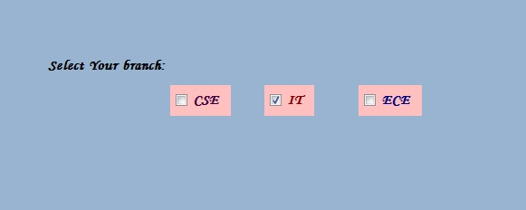
Checkbox
CheckBox control allows us to select single or multiple elements from the given list or it can provide us options like yes or no, true or false, etc.
K

Slide 14
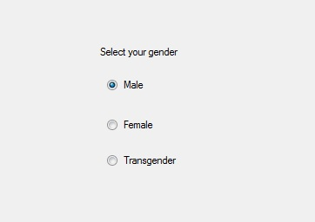
Radio Button
RadioButton control is used to select a single option among the group of the options.

Slide 15
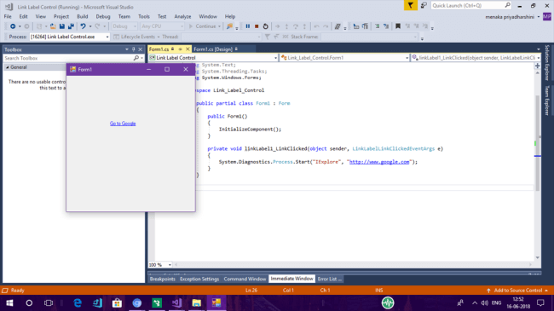
Link label
Hyperlinks are sometimes useful in Windows Forms programs. LinkLabel control provides hyperlinks similar to those on Web Pages. This control has some complexities and must be initialized in C# code.
private void linkLabel1_LinkClicked(object sender, LinkLabelLinkClickedEventArgs e)
{
System.Diagnostics.Process.Start("IExplore", "http://www.google.com");
}

Slide 16
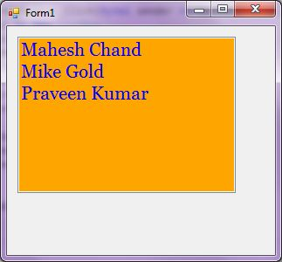
Listbox control
ListBox control is used to show multiple elements in a list, from which a user can select one or more elements and the elements are generally displayed in multiple columns

Slide 17
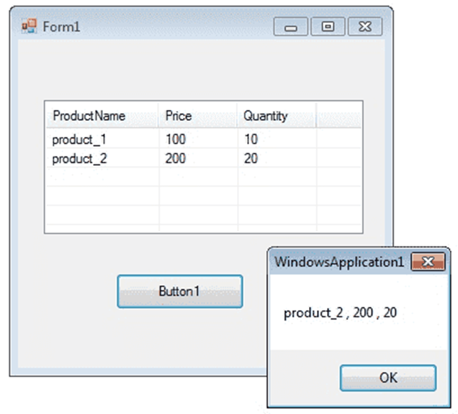
Listview
string[] arr = new string[4];
ListViewItem itm;
//add items to ListView
arr[0] = "product_1";
arr[1] = "100";
arr[2] = "10";
itm = new ListViewItem(arr);
listView1.Items.Add(itm);

Slide 18
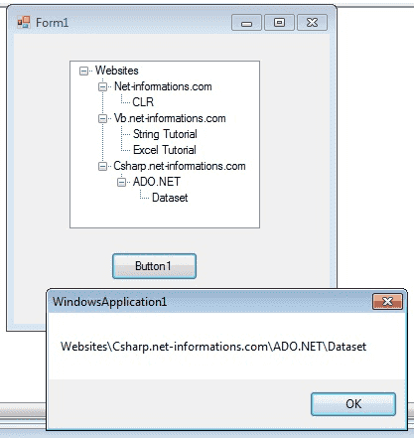
Treeview Control
The TreeView control contains a hierarchy of TreeViewItem controls. It provides a way to display information in a hierarchical structure by using collapsible nodes .
The top level in a tree view are root nodes that can be expanded or collapsed if the nodes have child nodes.

Slide 19
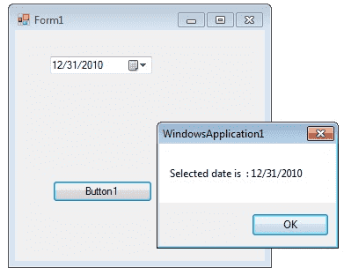
DateTimePicker Control
The DateTimePicker control allows you to display and collect date and time from the user with a specified format.

